Slide 1
RESPONSIVE IMAGE GALLERY
MULTIPAGE SITES

Slide 2
Enhancing a Web Site with Advanced CSS

Slide 3
WEB DESIGN
Transparent Backgrounds

Slide 4
Web Development & Design Foundations with HTML
KEY CONCEPTS

Slide 5
Layout with Styles.
COMTROLLING PAGE LAYOUT.

Slide 6
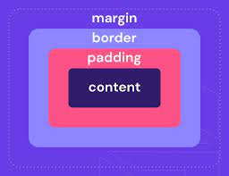

Slide 7
HTML
CSS
JAVA

Slide 8
HOW HTML RESPONSIVENESS TRANSLATE TO PDF

Slide 9
Lecture
Cascading Style Sheets(css) Internal Style Sheets Classes.

